Slide 1









Slide 2



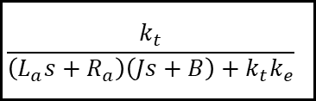
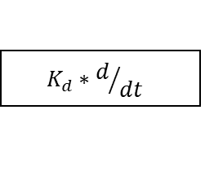


$$K_{P}$$
SP
err
+
CO
Y
+
$$\frac{k_{t}}{\left(L_{a}s+R_{a}\right)\left(Js+B\right)+k_{t}k_{e}}$$
$$K_{I}∗\int{dt}$$
+
-
传递函数
FB
$$K_{d}∗d/{dt}$$
系统结构图化简
${L_{a}\frac{di_{a}}{dt}+R_{a}i}_{a}=u_{a}$- $K_{e}ω$
$$\left(L_{a}s+R_{a}\right)I_{a}\left(s\right)=U_{a}\left(s\right)−K_{e}ω\left(s\right)$$
$J\frac{dω}{dt}+Bω =k_{t}∙i_{a}$- $T_{L}$
$$\left(Js+B\right)ω\left(s\right)=K_{t}I_{a}\left(s\right)−T_{L}$$

Slide 3



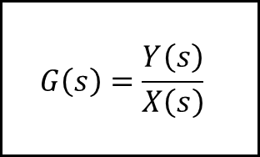





$$G\left(s\right)=\frac{Y\left(s\right)}{X\left(s\right)}$$
$$x\left(t\right)$$
$$y\left(t\right)$$

Slide 4




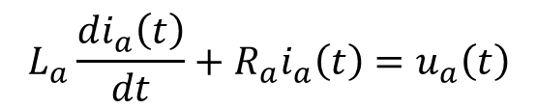
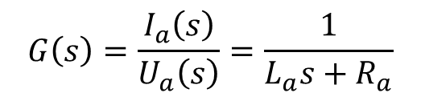





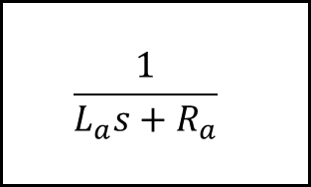
例题：忽略电机反电动势e，求输入为Ua，输出为ia时的传递函数
$$L_{a}\frac{di_{a}\left(t\right)}{dt}+R_{a}i_{a}\left(t\right)=u_{a}\left(t\right)$$
微分方程：
拉普拉斯变换
Ra
La
$$L_{a}sI_{a}\left(s\right)+R_{a}I_{a}\left(s\right)=U_{a}\left(s\right)$$
Ua(t)
ia(t)
合并同类项
e(t)=keω(t)
s域方程：
$$\left(L_{a}s+R_{a}\right)I_{a}\left(s\right)=U_{a}\left(s\right)$$
相除
$$\frac{1}{L_{a}s+R_{a}}$$
$$G\left(s\right)=\frac{I_{a}\left(s\right)}{U_{a}\left(s\right)}=\frac{1}{L_{a}s+R_{a}}$$
$$u_{a}$$
$$i_{a}$$

Slide 5


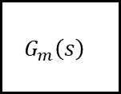

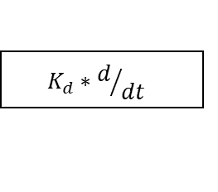
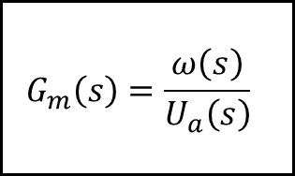

$$K_{P}$$
SP
err
+
CO
Y
+
$$G_{m}\left(s\right)$$
$$K_{I}∗\int{dt}$$
+
-
FB
$$K_{d}∗d/{dt}$$
$$G_{m}\left(s\right)=\frac{ω\left(s\right)}{U_{a}\left(s\right)}$$
$$U_{a}$$
$$ω$$

Slide 6






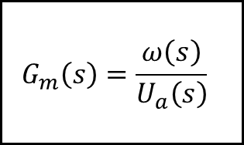




$$K_{P}$$
SP
err
+
CO
Y
+
$$G_{m}\left(s\right)$$
$$K_{I}∗\int{dt}$$
+
-
FB
$$K_{d}∗d/{dt}$$
$$\left(L_{a}s+R_{a}\right)I_{a}\left(s\right)=U_{a}\left(s\right)−K_{e}ω\left(s\right)$$
$$G_{m}\left(s\right)=\frac{ω\left(s\right)}{U_{a}\left(s\right)}$$
$$U_{a}$$
$$ω$$
$$\left(Js+B\right)ω\left(s\right)=K_{t}I_{a}\left(s\right)−T_{L}$$

Slide 7


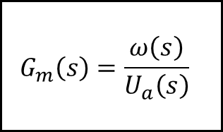

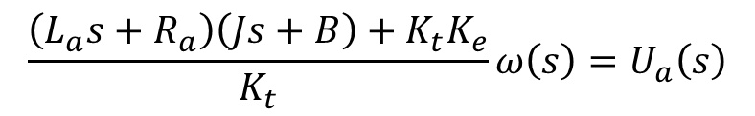

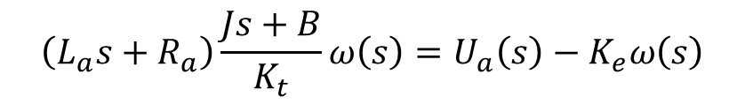



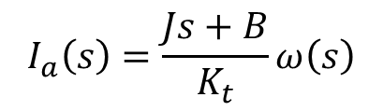
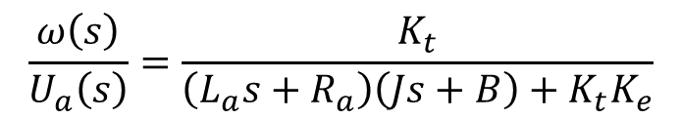
$$G_{m}\left(s\right)=\frac{ω\left(s\right)}{U_{a}\left(s\right)}$$
$$I_{a}\left(s\right)=\frac{Js+B}{K_{t}}ω\left(s\right)$$
$$U_{a}$$
$$ω$$
由②得
$$\left(L_{a}s+R_{a}\right)\frac{Js+B}{K_{t}}ω\left(s\right)=U_{a}\left(s\right)−K_{e}ω\left(s\right)$$
代入①中
$$\left(L_{a}s+R_{a}\right)I_{a}\left(s\right)=U_{a}\left(s\right)−K_{e}ω\left(s\right)$$
①
合并同类项
$$\frac{\left(L_{a}s+R_{a}\right)\left(Js+B\right)+K_{t}K_{e}}{K_{t}}ω\left(s\right)=U_{a}\left(s\right)$$
$$\left(Js+B\right)ω\left(s\right)=K_{t}I_{a}\left(s\right)−T_{L}$$
②
$$\frac{ω\left(s\right)}{U_{a}\left(s\right)}=\frac{K_{t}}{\left(L_{a}s+R_{a}\right)\left(Js+B\right)+K_{t}K_{e}}$$
相除

Slide 8

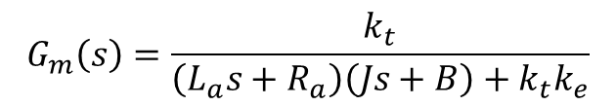
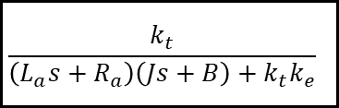
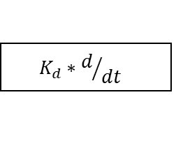

$$K_{P}$$
SP
err
+
CO
Y
+
$$\frac{k_{t}}{\left(L_{a}s+R_{a}\right)\left(Js+B\right)+k_{t}k_{e}}$$
$$K_{I}∗\int{dt}$$
+
-
FB
$$K_{d}∗d/{dt}$$
$$G_{m}\left(s\right)=\frac{k_{t}}{\left(L_{a}s+R_{a}\right)\left(Js+B\right)+k_{t}k_{e}}$$

